Slide 1
Chapter 27
Network
Security

Slide 2
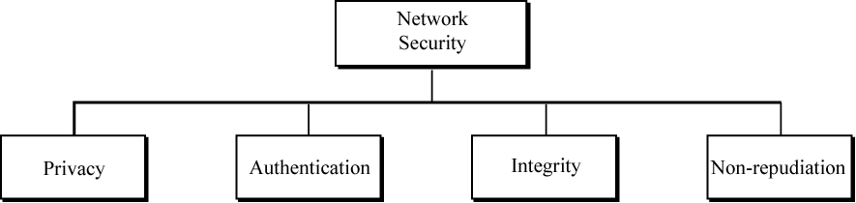
Figure 27-1
Aspects of security

Slide 3
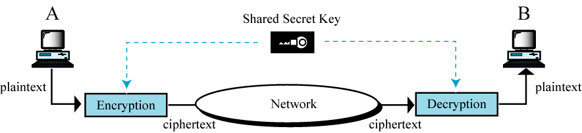
Figure 27-2
Secret key encryption

Slide 4
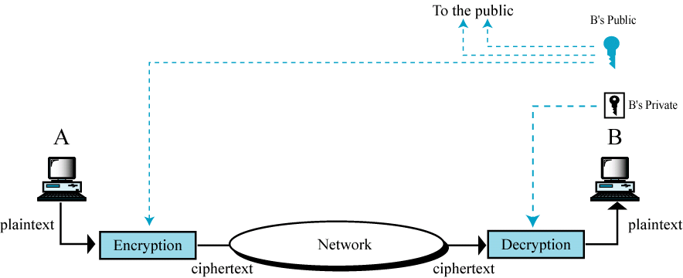
Figure 27-3
Public key encryption

Slide 5
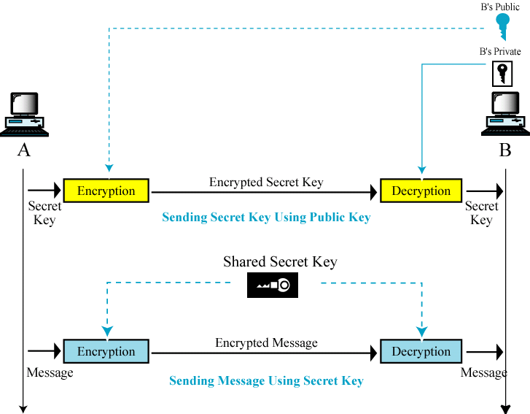
Figure 27-4
Combination

Slide 6
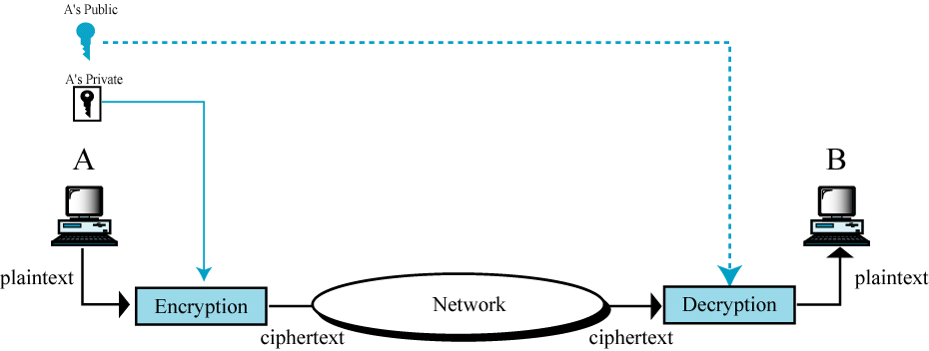
Figure 27-5
Signing the whole document

Slide 7
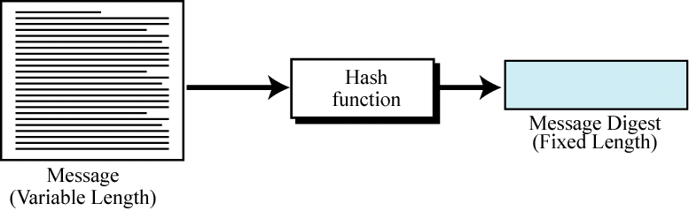
Figure 27-6
Signing the digest

Slide 8
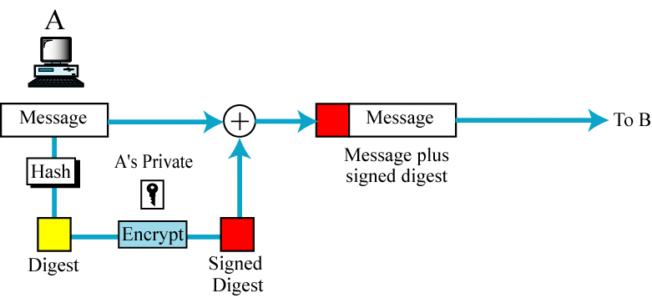
Figure 27-7
Sender site

Slide 9
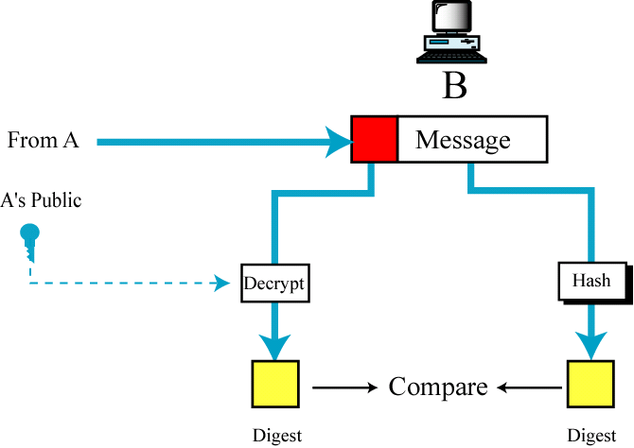
Figure 27-8
Receiver site

Slide 10
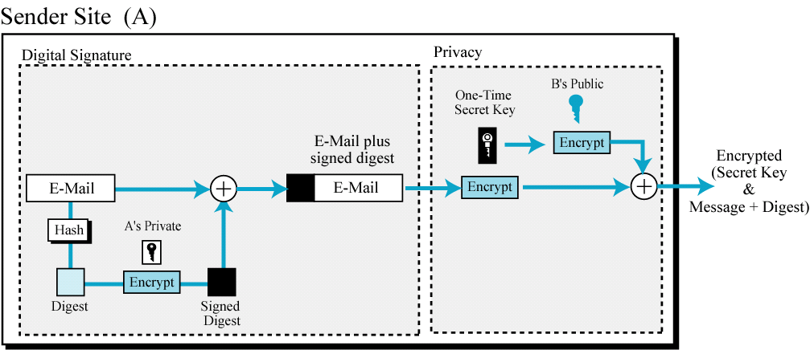
Figure 27-9
PGP at the sender site

Slide 11
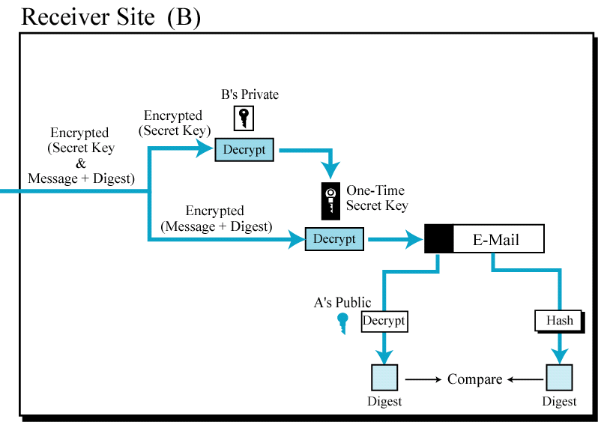
Figure 27-10
PGP at the receiver site

Slide 12
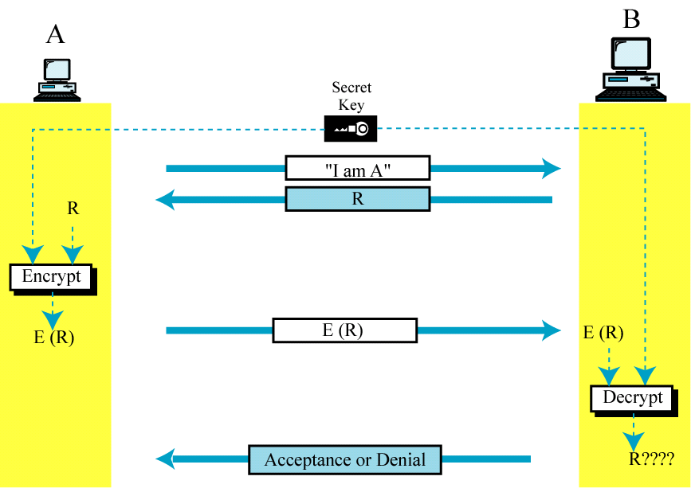
Figure 25-11
Access authorization with secret key encryption

Slide 13
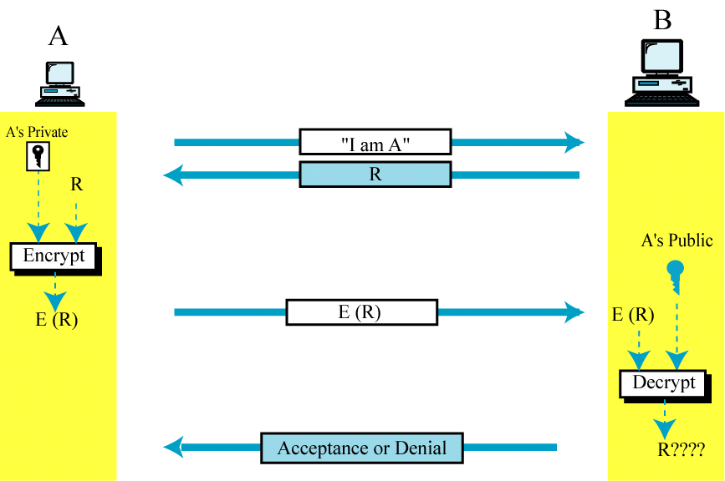
Figure 25-12
Access authorization with public key encryption

